Slide 1
CONTROL UNITS
UNIT - 2

Slide 2
TOPICS TO BE COVERED
Communication modules
Bluetooth
Zigbee
Wi-Fi
GPS
IoT Protocols
IPv6
6LoWPAN
RPL
CoAP
MQTT
Wired Communication
Power Sources

Slide 3
Bluetooth:
It is a Wireless Personal Area Network (WPAN) technology and is used for exchanging data over smaller distances.
Maximum devices that can be connected at the same time are 7. Bluetooth ranges up to 10 meters.
It provides data rates up to 1 Mbps or 3 Mbps depending upon the version
A Bluetooth network is called a piconet and a collection of interconnected piconets is called scatternet.

Slide 4
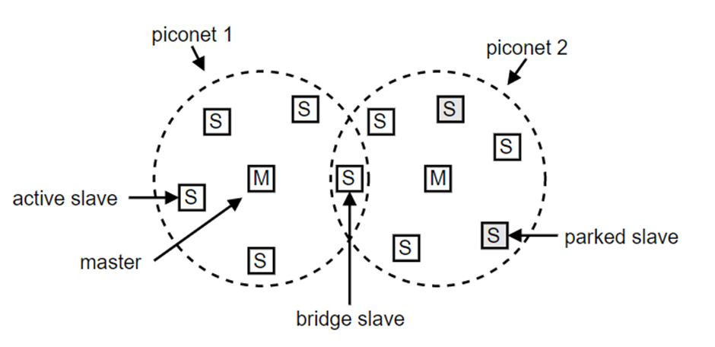
Bluetooth Architecture:

Slide 5
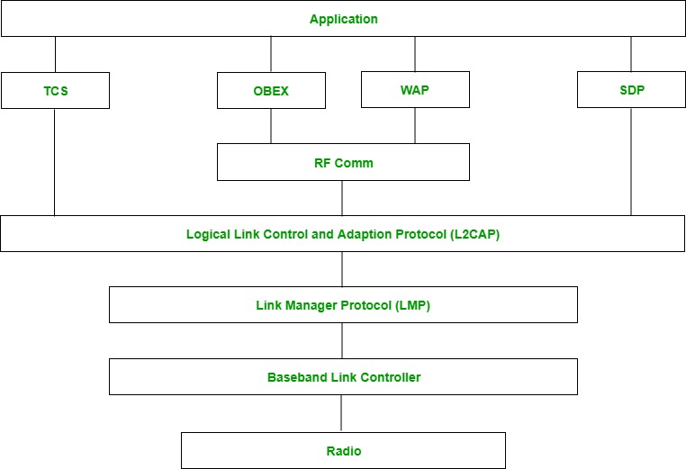
Bluetooth protocol stack:

Slide 6
1.Radio (RF) layer: It performs modulation/demodulation of the data into RF signals. It defines the physical characteristics of Bluetooth transceivers.
2.Baseband Link layer: The baseband is the digital engine of a Bluetooth system and is equivalent to the MAC sublayer in LANs. It performs the connection establishment within a piconet.
3.Link Manager protocol layer: It performs the management of the already established links which includes authentication and encryption processes. It is responsible for creating the links, monitoring their health, and terminating them gracefully upon command or failure.

Slide 7
4.Logical Link Control and Adaption Protocol layer: It is also known as the heart of the Bluetooth protocol stack. It allows the communication between upper and lower layers of the Bluetooth protocol stack. It packages the data packets received from upper layers into the form expected by lower layers. It also performs segmentation and multiplexing.
5.SDP layer: It is short for Service Discovery Protocol. It allows discovering the services available on another Bluetooth-enabled device.
6.RF comm layer: It is short for Radio Frontend Component. It provides a serial interface with WAP and OBEX. It also provides emulation of serial ports over the logical link control and adaption protocol(L2CAP). The protocol is based on the ETSI standard TS 07.10.

Slide 8
7.OBEX: It is short for Object Exchange. It is a communication protocol to exchange objects between 2 devices.
8.WAP: It is short for Wireless Access Protocol. It is used for internet access.
9.TCS: It is short for Telephony Control Protocol. It provides telephony service. The basic function of this layer is call control (setup & release) and group management for gateway serving multiple devices.
10.Application layer: It enables the user to interact with the application.

Slide 9
ZigBee
• ZigBee is an IEEE 802.15.4 based, low power, low data rate supporting wireless networking standard, which is basically used for two-way communication between sensors and control system.
• It is a short-range communication standard like Bluetooth and Wi-Fi, covering range of 10 to 100 meters.
• The difference being while Bluetooth and Wi-Fi are high data rate communications standard supporting transfer of complex structure like media, software etc.,
•It supports low data rate of about 250 kbps.
•The operating frequencies are 868 MHz, 902 to 928 MHz and 2.4 GHz.
•ZigBee Technology is used mainly for applications requiring low power, low cost, low data rate and long battery life.

Slide 10
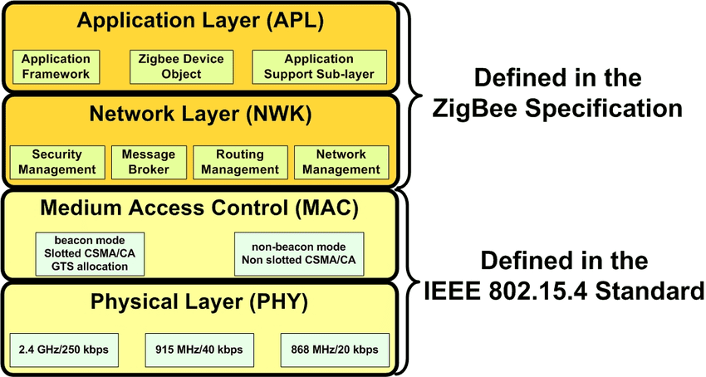
Architecture of Zigbee:

Slide 11
Physical Layer:
Physical Layer is responsible for the following functions:
• Activation and deactivation of transmission and reception.
• Channel selection and its assessment.
• Sending and receiving of packets.
• Energy detection within the channel.

Slide 12
Medium Access Control or MAC Layer:
Medium Access Control (MAC) Layer is responsible for the following:
• CSMA-CA (Carrier Sense Multiple Access with Collision Avoidance) is implemented.
• Data frame validation and acknowledgement.
• Data transfer for upper layers.

Slide 13
Medium Access Control or MAC Layer:
Data handling and data management are the two main functions of the MAC layer. Data handling includes functions such as “Data Request” and “Data Confirm”. The MAC layer adds destination address and transmits options for the outgoing data frames.
When the Zigbee network layer calls the “data request” function, the data gets formatted into relevant MAC header and frame length is added which is the physical header. The data frame is ready to be transmitted.
The purpose of “Data Confirm” function is to communicate the status of the transmitted data. It sends a failure status when the transmission frames exceeds or when there is no response to transmitted data.

Slide 14
Network Layer:
Network Layer in Zigbee architecture is responsible for the following functions:
• Initiation of a network
• Assigning node addresses
• Configuring of new devices
• Providing secured transmission

Slide 15
Network Layer:
Network Layer provides interface between MAC layer and the application layer.
When a coordinator attempts to establish a Zigbee network, an energy scan is initiated to find the best RF channel for its new network. When a channel has been chosen, the coordinator assigns a PAN-ID which will be applied to all the devices that join the network.
PAN-ID is a 16-bit number that is used as a network identifier. A node is allowed to communicate on a network only when it undergoes the association process. The association function is used to join a node to a parent.

Slide 16
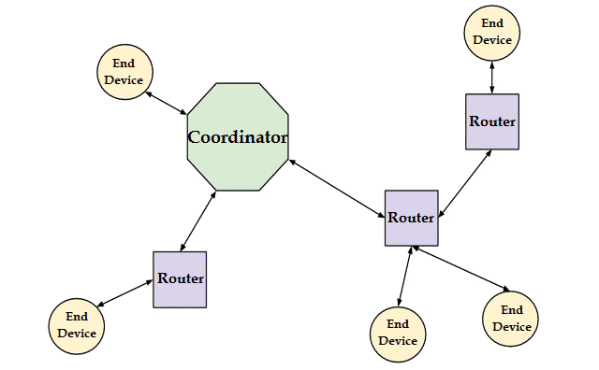
Network Layer:

Slide 17
Application Layer:
The Application Layer in Zigbee architecture consists of sub layers namely:
• Application Support Sub Layer
• Application Framework

Slide 18
Application Support Sub Layer (APS)
This layer is responsible for filtering of packets for end devices, checks for duplicity of packets which is common in a network that supports automatic retries. To maximize the chance of successful transmission, it performs automatic retries, when the acknowledgement is requested by the sender.
It is involved in maintaining binding tables. Binding is the connection between the endpoint on the node to one or more endpoints on other nodes. The address mapping associates a 64-bit MAC address with a Zigbee 16-bit network address

Slide 19
Application Support Sub Layer (APS)
Application Support Sub Layer (APS) is responsible for the following functions:
• Maintaining binding tables.
• Address definition, mapping, and management.
• Ensuring communication between devices.
• Filtering out packets for non-registered end devices or profiles that don’t match and reassembling of the packets.

Slide 20
Application Framework
The Application Framework depends on the vendor who has chosen for specific applications to interact with Zigbee protocol. This represents how end points are implemented, how data requests and data confirmation is executed for that particular vendor.

Slide 21
Wi-Fi
• WiFi stands for Wireless Fidelity.
• It is based on the IEEE 802.11 family of standards and is primarily a local area networking (LAN) technology designed to provide in-building broadband coverage.
• Current WiFi systems support a peak physical-layer data rate of 54 Mbps and typically provide indoor coverage over a distance of 100 feet.

Slide 22
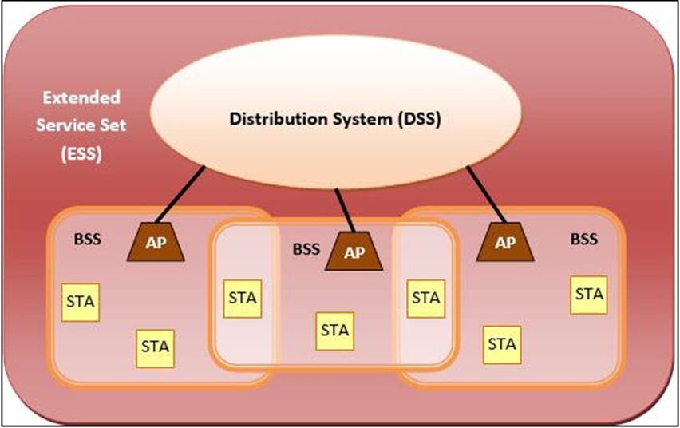
IEEE 802.11 Architecture

Slide 23
IEEE 802.11 Architecture
The components of an IEEE 802.11 architecture are as follows
1) Stations (STA) − Stations comprise all devices and equipments that are connected to the wireless LAN. A station can be of two types:
• Wireless Access Points (WAP) − WAPs or simply access points (AP) are generally wireless routers that form the base stations or access.
• Client. − Clients are workstations, computers, laptops, printers, smartphones, etc.
Each station has a wireless network interface controller.
2) Basic Service Set (BSS) −A basic service set is a group of stations communicating at physical layer level.
3) Extended Service Set (ESS) − It is a set of all connected BSS.
4) Distribution System (DSS) − It connects access points in ESS.

Slide 24
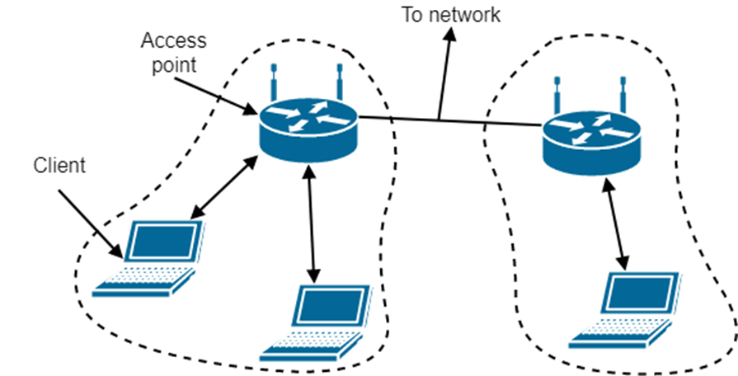
802.11 networks modes
Infrastructure mode uses an AP (Access Point) that is connected to the network. Clients send and receive packets via the AP. Several APs can be connected to form an extended network

Slide 25
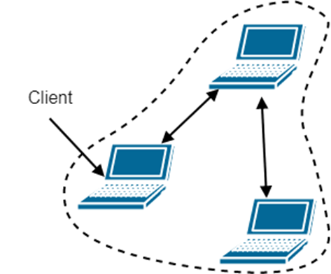
802.11 networks modes
Ad-hoc mode is a collection of computers connected to each other so that they can send frames to each other. There’s no AP

Slide 26
802.11 Protocol Entities
LLC
SAP
MAC Sublayer
MAC Layer
Management
MAC
Station
Management
PLCP Sublayer
PHY
PHY Layer
Management
PMD Sublayer
Notes:
7

Slide 27
802.11 Protocol Architecture
MAC Entity
basic access mechanism
fragmentation/defragmentation
encryption/decryption
MAC Layer Management Entity
synchronization
power management
roaming
MAC MIB (management information base)
Physical Layer Convergence Protocol (PLCP)
PHY-specific, supports common PHY SAP
provides Clear Channel Assessment signal (carrier sense)
Notes:
8

Slide 28
802.11 Protocol Architecture (cont.)
Physical Medium Dependent Sublayer (PMD)
modulation and encoding
PHY Layer Management
channel tuning (channel switching delay : 224us in 802.11b)
PHY MIB
Station Management
interacts with both MAC Management and PHY Management
Notes:
9

Slide 29
GPS
• GPS stands for Global Positioning System. GPS is a satellite-based navigation system that allows ground users to provide their exact location, velocity, and time 24 hours a day, in all weather conditions, all over the world.
• GPS developed by the U.S. Department of Défense. It was basically designed to assist soldiers and military
• The GPS systems are a Combination of a network of satellites that are constantly sending coded information in the form of radio signals. After that receiver received the signals and interprets the transmitted information from the satellites to locate the position on earth accurately.

Slide 30
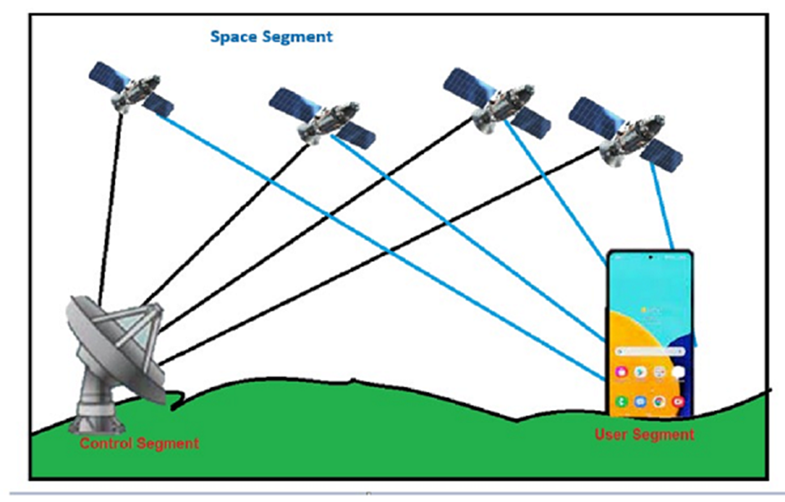
GPS

Slide 31
Architecture of GPS:
GPS Architecture is basically divided into three segments.
• Space Segment (SS)
• Control Segment (CS)
• User Segment (US)

Slide 32
Space segment:
• The space segment (SS) is composed of the orbiting GPS satellites, or Space Vehicles (SV).
• The GPS design originally called for 24 SVs, eight each in three circular orbital planes.
• This was modified to six planes with four satellites each.
• The orbital planes are centered on the Earth.
• The six planes have approximately 55° inclination and are separated by 60° right ascension of the ascending node.

Slide 33
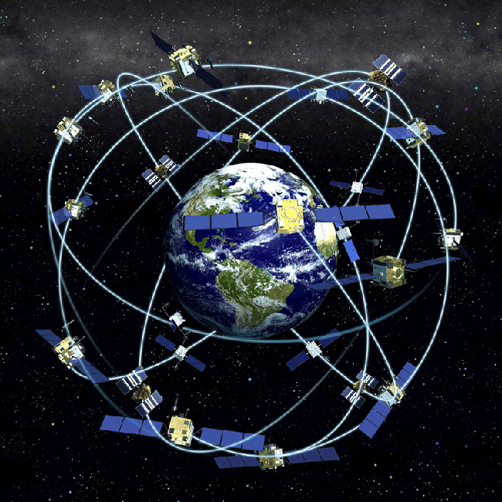
Space segment:

Slide 34
Space segment:
• The orbits are arranged so that at least six satellites are always within line of sight from almost everywhere on Earth's surface.
• Satellites are orbiting at an altitude of approximately 20,200 kilometers.
• Each SV makes two complete orbits each sidereal day, repeating the same ground track.
• As of March 2008, there are 31 actively broadcasting satellites in the GPS constellation.
• The additional satellites improve the precision of GPS receiver calculations by providing redundant measurements.

Slide 35
Control Segment:
• The GPS-System is controlled by the US Army. The “master control station” and four additional monitoring stations were set up for monitoring the satellites.
• The Control Segment is composed of
1. A Master Control Station (MCS)
2. An Alternate Master Control Station,
3. Four dedicated Ground Antennas
4. Six dedicated Monitor Stations

Slide 36
Control Segment:
• The flight paths of the satellites are tracked by dedicated U.S. Air Force monitoring stations in
1. Hawaii
2. Kwajalein
3. Ascension Island
4. Diego Garcia
5. Colorado Springs
• Monitor stations operated in England, Argentina, Ecuador, Bahrain, Australia and Washington DC.

Slide 37
Control Segment:
• During August and September 2005, six more monitor stations of the National Geospatial-Intelligence Agency were added to the grid. Now, every satellite can be seen from at least two monitor stations.
• This allows calculating more precise orbits and ephemeris data. For the end user, a better position precision can be expected from this.
• In the near future, five more stations will be added so that every satellite can be seen by at least three monitor stations. This improves integrity monitoring of the satellites and thus the whole system.

Slide 38
User Segment:
• The User Segment is composed of hundreds of thousands of U.S. and allied military users of the secure GPS Precise Positioning Service, and tens of millions of civil, commercial and scientific users of the Standard Positioning Service.
• In general, GPS receivers are composed of an antenna, tuned to the frequencies transmitted by the satellites, receiver-processors, and a highly-stable clock.

Slide 39
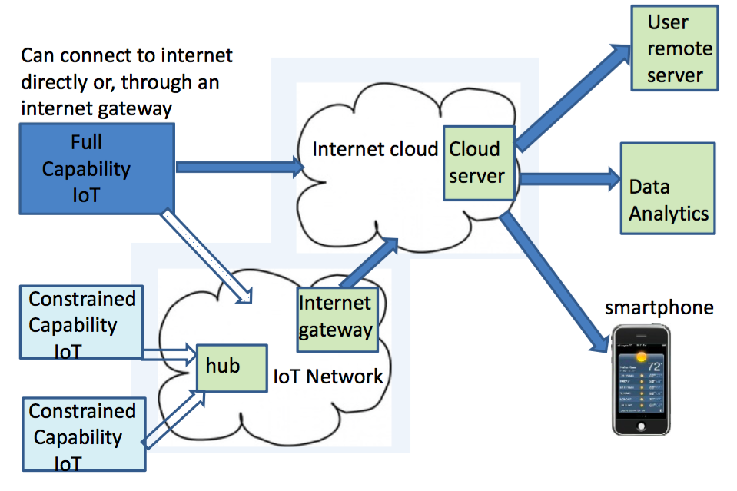
Simplified IoT System Architecture

Slide 40
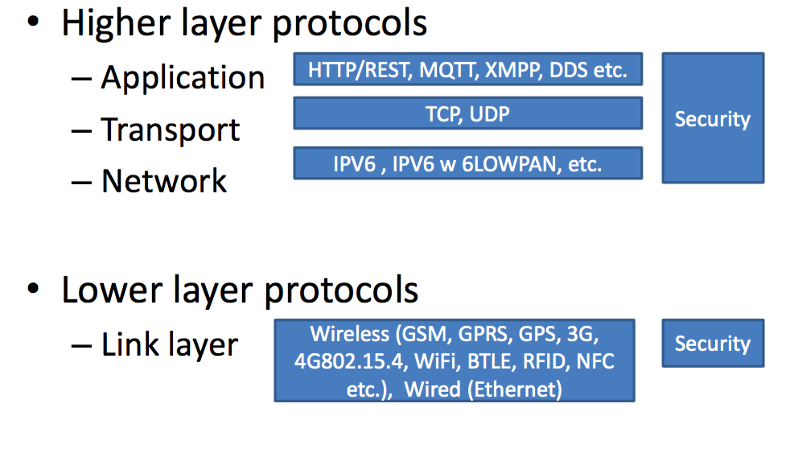
IoT Levels

Slide 41
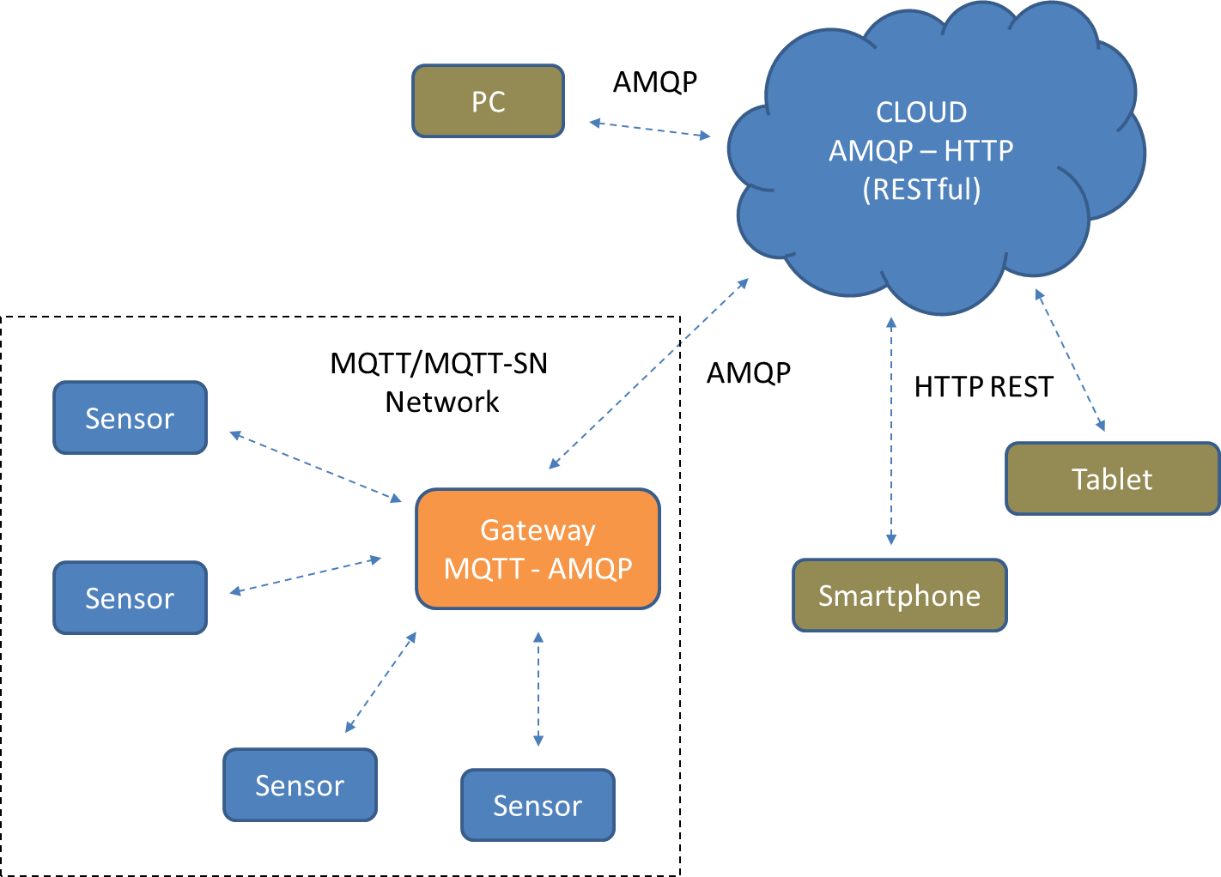
Protocols in Complex systems

Slide 42
IoT Protocol Stack

Slide 43
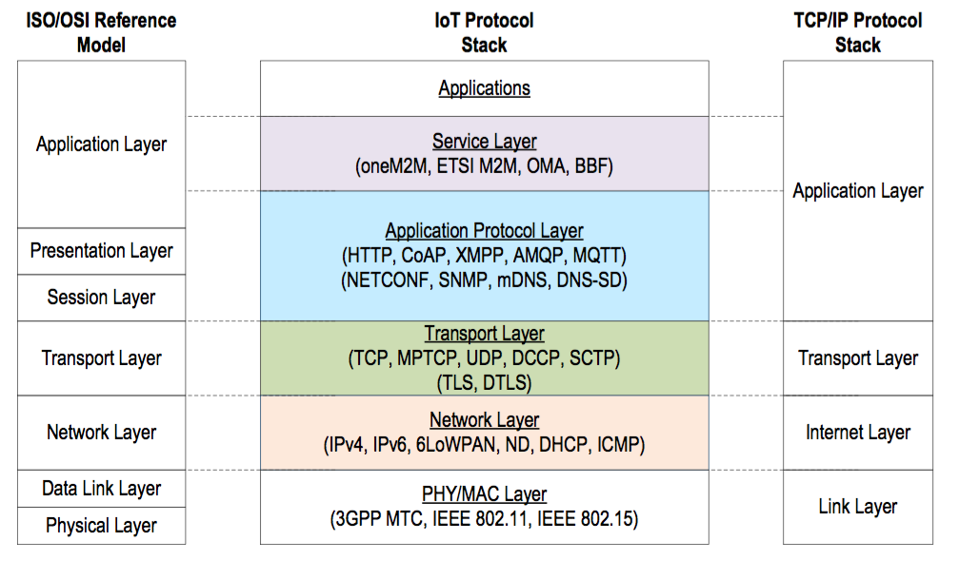
IoT Protocols and Standards

Slide 44
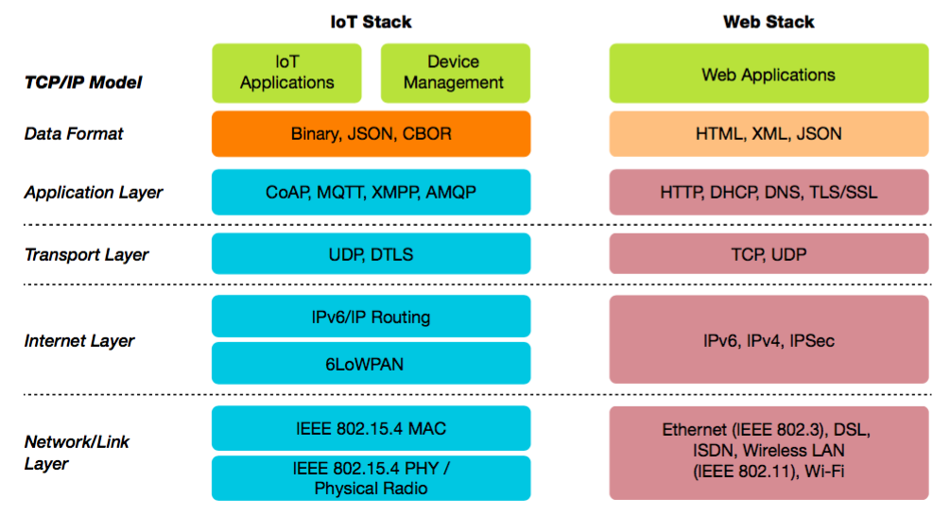
Standardized IoT Protocols

Slide 45
IoT Protocols
Infrastructure (ex: 6LowPAN, IPv4/IPv6, RPL)
Identification (ex: EPC, uCode, IPv6, URIs)
Comms / Transport (ex: Wifi, Bluetooth, LPWAN)
Discovery (ex: Physical Web, mDNS, DNS-SD)
Data Protocols (ex: MQTT, CoAP, AMQP, Websocket, Node)
Device Management (ex: TR-069, OMA-DM)
Semantic (ex: JSON-LD, Web Thing Model)
Multi-layer Frameworks (ex: Alljoyn, IoTivity, Weave, Homekit)

Slide 46
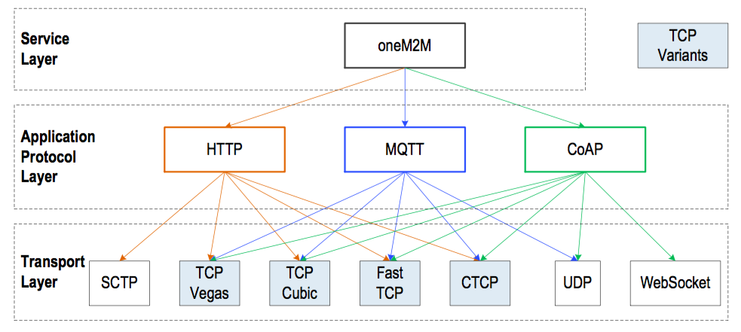
IoT Protocol Stack

Slide 47
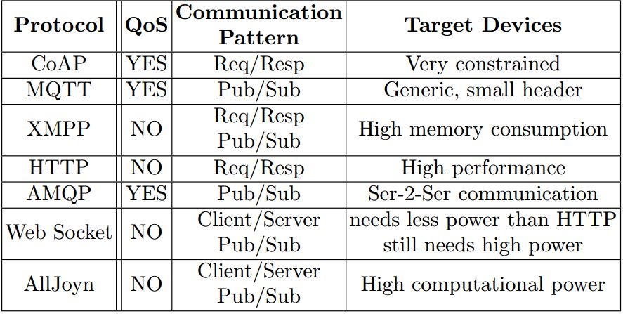
IoT Application Layer Protocols
Most popular application layer protocols used nowadays:
CoAP: Constrained Application Protocol
MQTT: Message Queuing Telemetry Transport
XMPP: Extensible Messaging and Presence Protocol
AMQP: Advanced Message Queuing Protocol
WebSocket: Computer Communications Protocol
Alljoyn: Full stack of protocols intended for IoT. Not separable application layer protocol

Slide 48
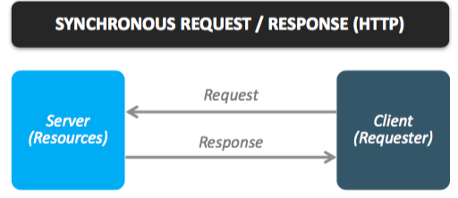
IoT Messaging Protocols

Slide 49
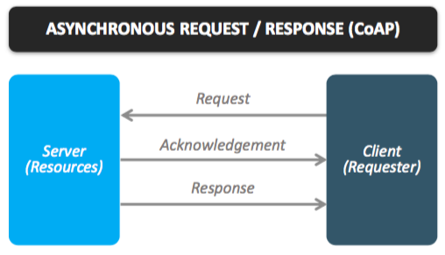
IoT Messaging Protocols

Slide 50
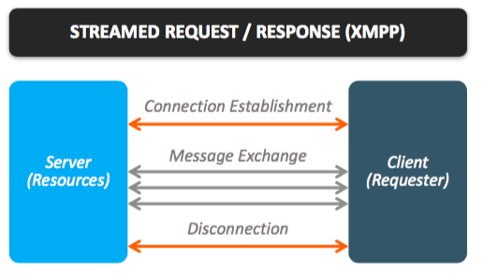
IoT Messaging Protocols

Slide 51
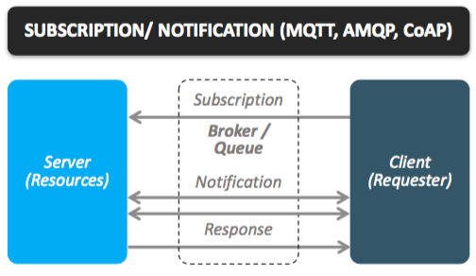
IoT Messaging Protocols

Slide 52
Where to find the specifications?
HTTP
IETF standard (RFC 2616 is HTTP/1.1)
CoAP
IETF standard (RFC 7252), http://coap.technology/
MQTT
OASIS standard
AMQP
OASIS and ISO 19464 standard (1.0)

Slide 53
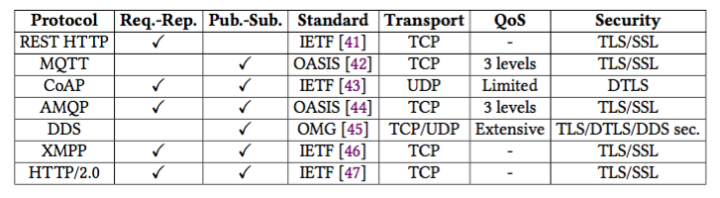
Application layer protocols main features comparison

Slide 54
MQTT - Message Queueing Telemetry Transport

Slide 55
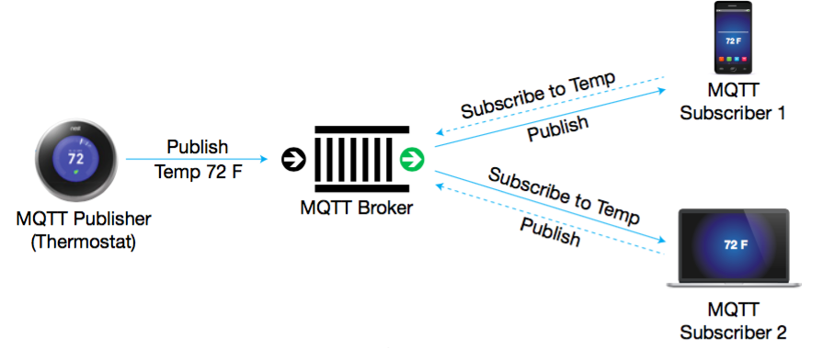
MQTT in the world of IoT

Slide 56
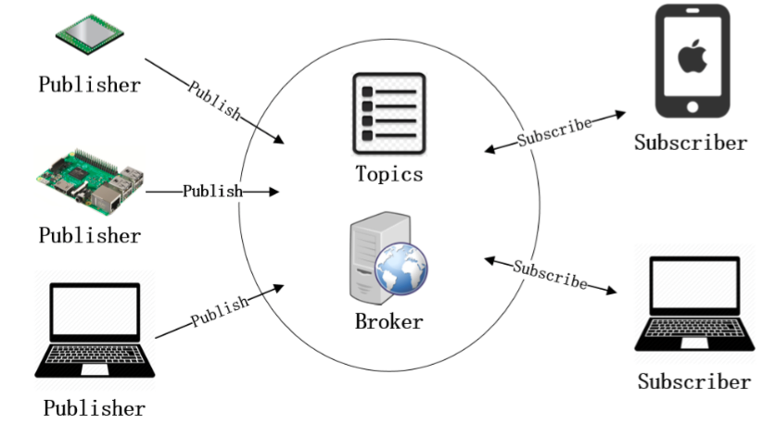
MQTT Architecture

Slide 57
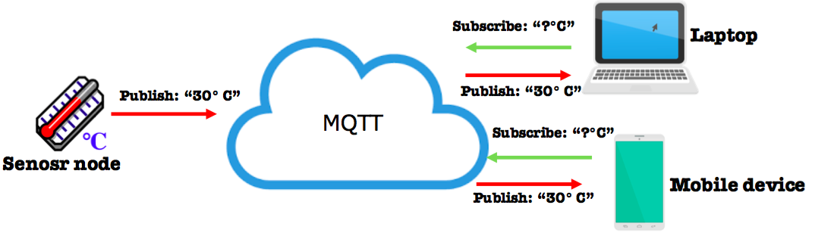
MQTT Communication Pattern
Publish/Subscribe paradigm
Clients and publisher don’t know each other
One-to-Many paradigm
Every client publishes & subscribes
PUSH information paradigm compared to PULL’s one in COAP

Slide 58
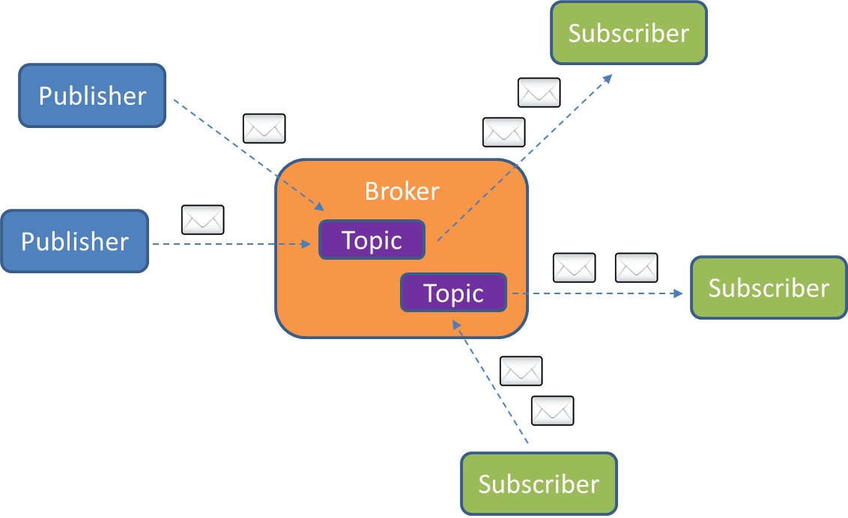
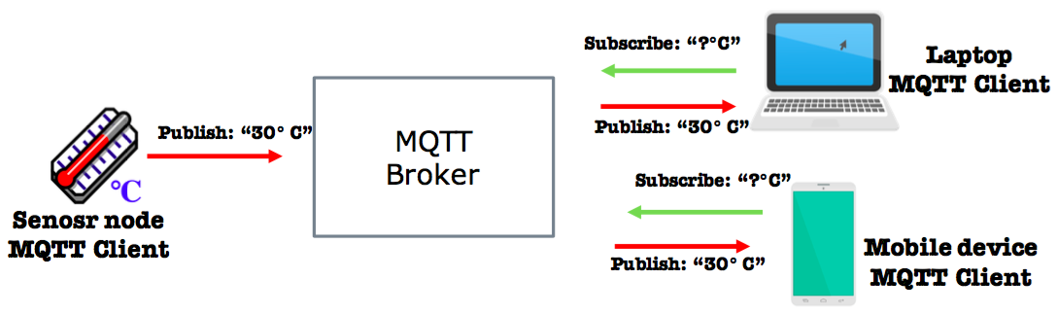
MQTT Components
Broker and connected Clients
broker receives subscriptions from clients on topics
broker receives messages and forward them
clients subscribe/publish on topics
Brokers bridge configuration

Slide 59
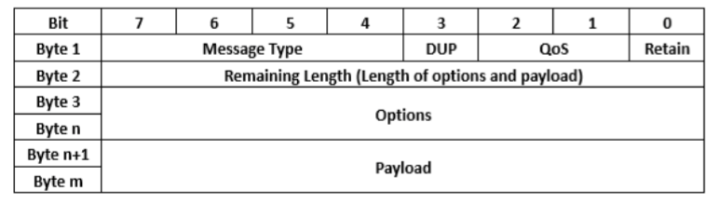
MQTT Packet Format

Slide 60
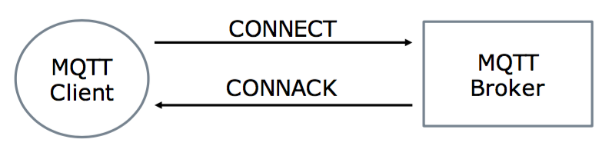
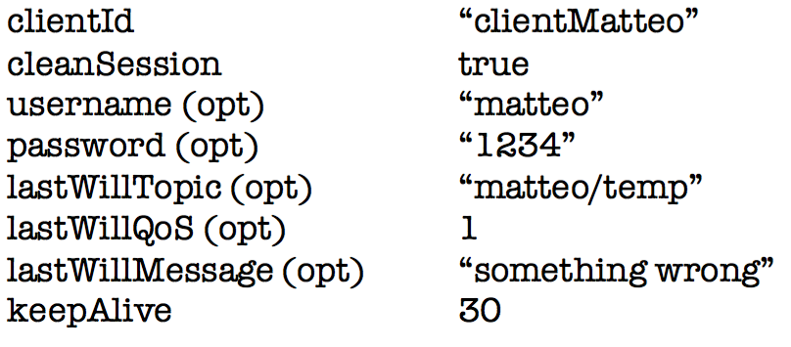
MQTT Open Connection
CONNECT message fields:

Slide 61
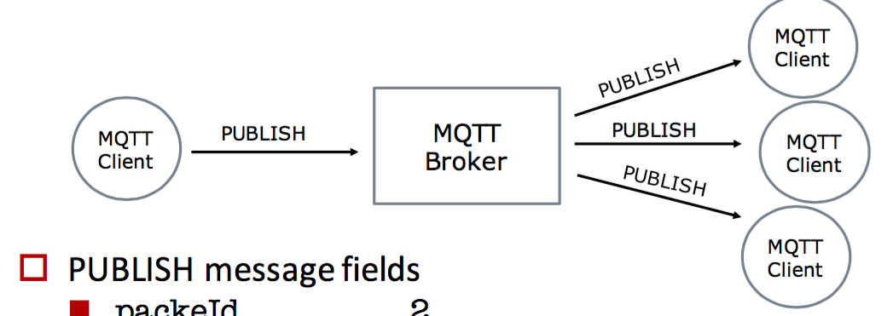
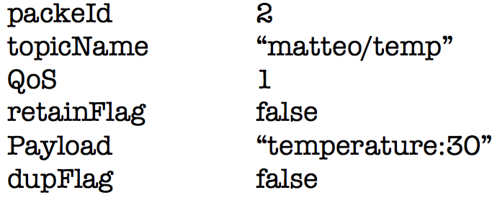
MQTT Publishing
PUBLISH message fields:

Slide 62
Quality of Service (QoS) in MQTT
The Quality of Service (QoS) level is an agreement between the sender of a message and the receiver of a message that defines the guarantee of delivery for a specific message. There are 3 QoS levels in MQTT:
At most once (0)
At least once (1)
Exactly once (2).

Slide 63
When you talk about QoS in MQTT, you need to consider the two sides of message delivery:
Message delivery form the publishing client to the broker.
Message delivery from the broker to the subscribing client.
The client that publishes the message to the broker defines the QoS level of the message when it sends the message to the broker. The broker transmits this message to subscribing clients using the QoS level that each subscribing client defines during the subscription process. If the subscribing client defines a lower QoS than the publishing client, the broker transmits the message with the lower quality of service.

Slide 64
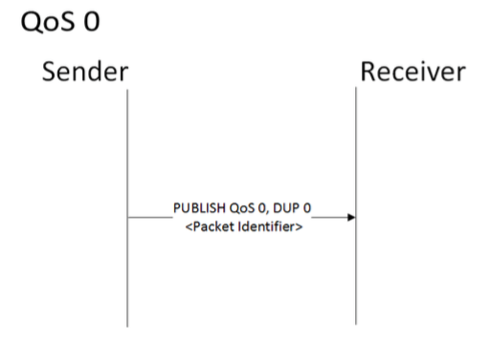
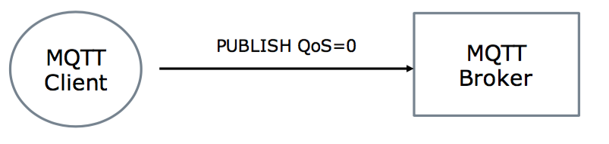
MQTT QoS 0: “at most once”
The minimal QoS level is zero. This service level guarantees a best-effort delivery. There is no guarantee of delivery. The recipient does not acknowledge receipt of the message and the message is not stored and re-transmitted by the sender. QoS level 0 is often called “fire and forget” and provides the same guarantee as the underlying TCP protocol.

Slide 65
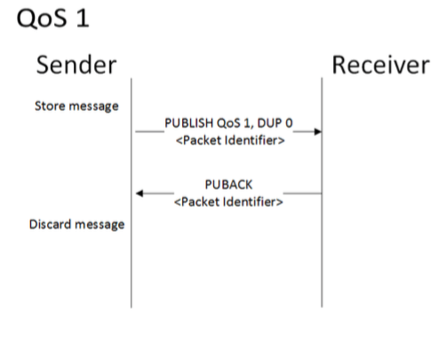
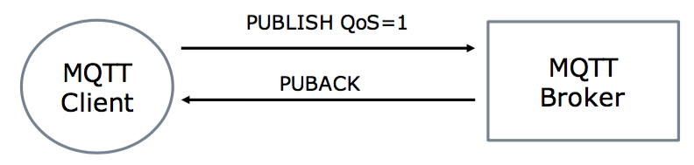
MQTT QoS 1: “at least once”
QoS level 1 guarantees that a message is delivered at least one time to the receiver. The sender stores the message until it gets a PUBACK packet from the receiver that acknowledges receipt of the message. It is possible for a message to be sent or delivered multiple times.

Slide 66
MQTT QoS 1: “at least once”
The sender uses the packet identifier in each packet to match the PUBLISH packet to the corresponding PUBACK packet. If the sender does not receive a PUBACK packet in a reasonable amount of time, the sender resends the PUBLISH packet. When a receiver gets a message with QoS 1, it can process it immediately. For example, if the receiver is a broker, the broker sends the message to all subscribing clients and then replies with a PUBACK packet.

Slide 67
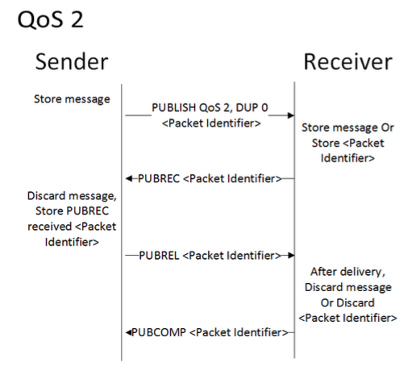
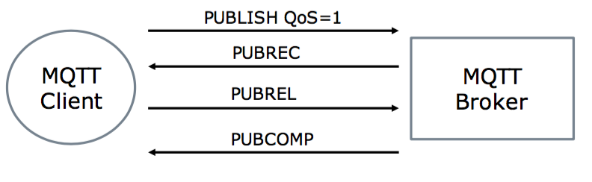
MQTT QoS 2: “exactly once”
QoS 2 is the highest level of service in MQTT. This level guarantees that each message is received only once by the intended recipients. QoS 2 is the safest and slowest quality of service level. The guarantee is provided by at least two request/response flows (a four-part handshake) between the sender and the receiver. The sender and receiver use the packet identifier of the original PUBLISH message to coordinate delivery of the message.

Slide 68
MQTT QoS 2: “exactly once”
When a receiver gets a QoS 2 PUBLISH packet from a sender, it processes the publish message accordingly and replies to the sender with a PUBREC packet that acknowledges the PUBLISH packet. If the sender does not get a PUBREC packet from the receiver, it sends the PUBLISH packet again with a duplicate (DUP) flag until it receives an acknowledgement
Once the sender receives a PUBREC packet from the receiver, the sender can safely discard the initial PUBLISH packet. The sender stores the PUBREC packet from the receiver and responds with a PUBREL packet.

Slide 69
MQTT QoS 2: “exactly once”
After the receiver gets the PUBREL packet, it can discard all stored states and answer with a PUBCOMP packet (the same is true when the sender receives the PUBCOMP). Until the receiver completes processing and sends the PUBCOMP packet back to the sender, the receiver stores a reference to the packet identifier of the original PUBLISH packet. This step is important to avoid processing the message a second time. After the sender receives the PUBCOMP packet, the packet identifier of the published message becomes available for reuse.

Slide 70
CoAP - Constrained Application Protocol

Slide 71
The main features of CoAP protocols are:
CoAP is a simple protocol with low overhead specifically designed for constrained devices (such as microcontrollers) and constrained networks. Asynchronous message exchange
Low overhead and very simple to parse
Web protocol used in M2M with constrained requirement
Proxy and caching capabilities

Slide 72
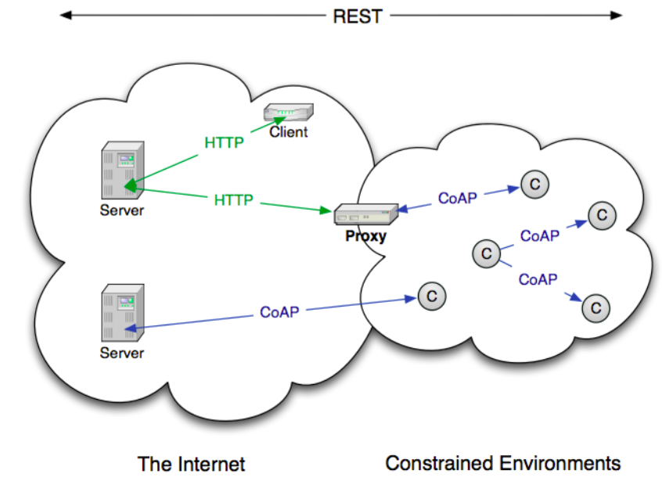
CoAP Architecture

Slide 73
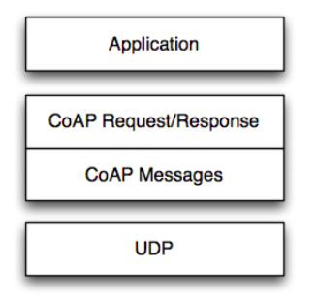
CoAP Message Semantics

Slide 74
CoAP supports four different message types:
Confirmable
Non-confirmable
Acknowledgment
Reset

Slide 75
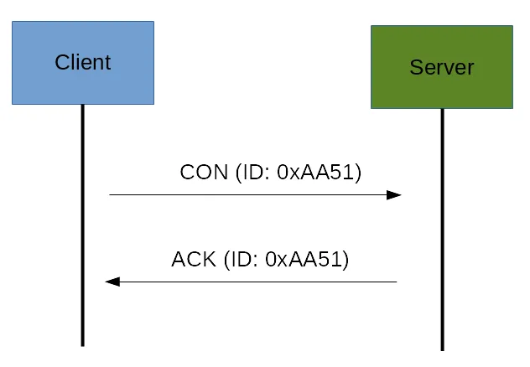
CoAP Messages Model
confirmable message

Slide 76
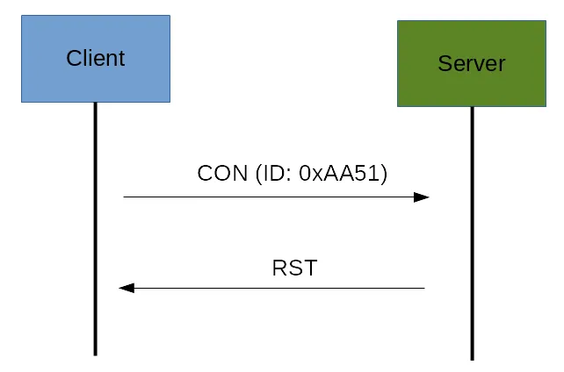
a Rest message (RST)

Slide 77
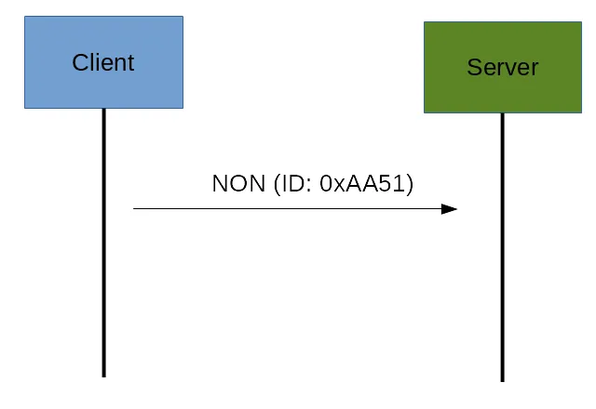
Non-confirmable (NON) messages

Slide 78
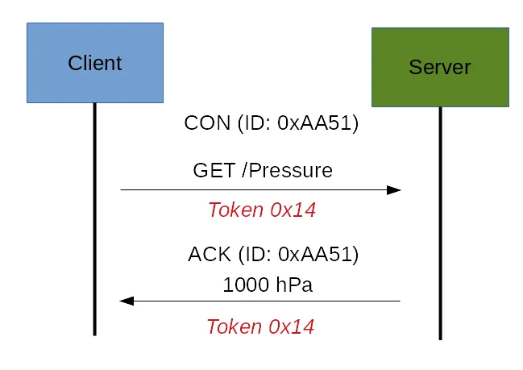
CoAp Request/Response Model
Confirmable message (CON)

Slide 79
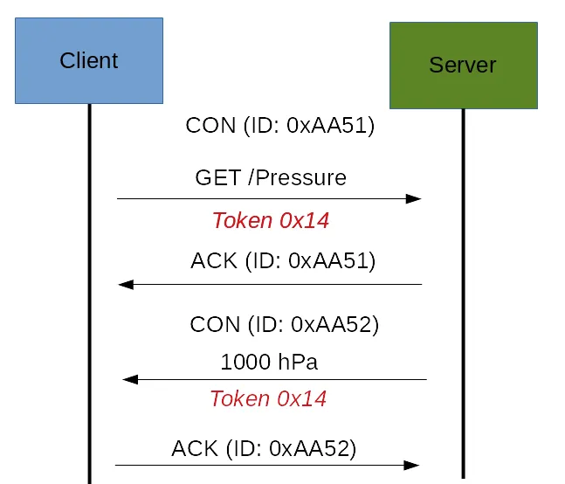
CoAp Request/Response Model
Confirmable message (CON)

Slide 80
NON-confirmable message
If the request coming from the client is carried using a NON-confirmable message, then the server answer using a NON-confirmable message.

Slide 81
XMPP - eXtensible Messaging and Presence Protocol

Slide 82
XMPP - eXtensible Messaging and Presence Protocol
XMPP is a short form for Extensible Messaging Presence Protocol. It’s protocol for streaming XML elements over a network in order to exchange messages and presence information in close to real time. This protocol is mostly used by instant messaging applications like WhatsApp.
Let’s dive into each character of word XMPP:
X : It means eXtensible. XMPP is a open source project which can be changed or extended according to the need.
M : XMPP is designed for sending messages in real time. It has very efficient push mechanism compared to other protocols.
P : It determines whether you are online/offline/busy. It indicates the state.
P : XMPP is a protocol, that is, a set of standards that allow systems to communicate with each other.

Slide 83
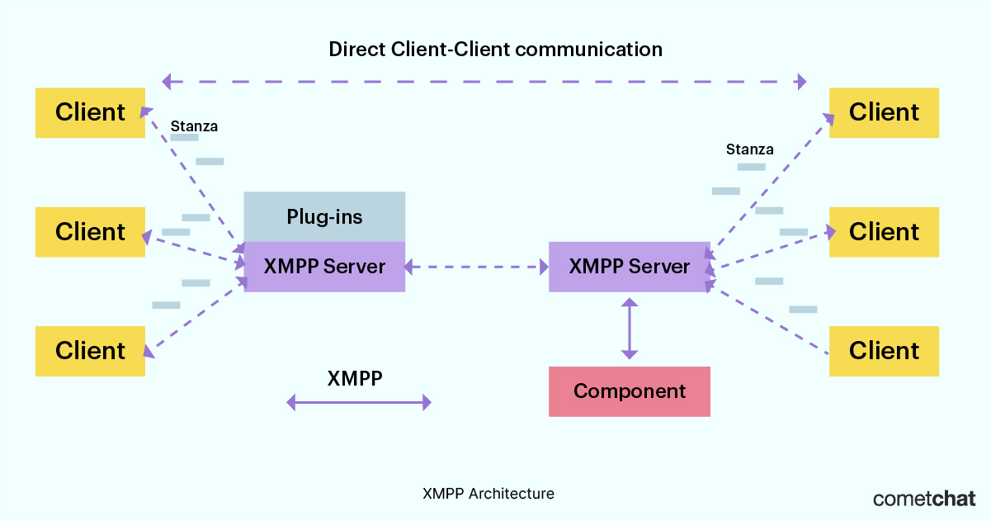
XMPP Architecture

Slide 84
XMPP Architecture
XMPP works on a client-server architecture. This means that when you send a message via XMPP, it's first sent to a server which then routes it to the correct client (user).
How does it know which client to send your message to?
each client connected to an XMPP server is assigned a unique identifier, known as a Jabber ID. The current format of the unique identifier is user@domain.com/resource.
• The user and domain parts of the unique identifier are pretty straightforward. User is the username of the person and domain.com is the domain of the client that’s sending the message.
• Resource refers to the type of device on which the message was sent. For example, mobile vs web. This part of the unique identifier is optional and is often only defined in situations where the client doesn't support every device.

Slide 85
XMPP Architecture
Using the unique identifier, an XMPP server can route each message to the correct client.
When a client initiates a session with an XMPP server, it opens a persistent TCP connection and starts an XML stream to the server. Once the client is identified by the server (via the unique identifier) and the connection is accepted, the server then opens an additional XML stream—with this stream going back to the client. The end result is a bi-directional stream of XML data.

Slide 86
AMQP - Advanced Message Queueing Protocol

Slide 87
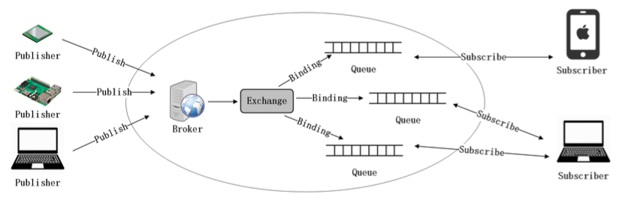
AMQP Architecture

Slide 88
AMQP
AMQP is an acronym used for the Advanced Message Queuing Protocol. It is a protocol that is used for communication between applications. It is a lightweight, protocol which supports the applications for transfer of data. This protocol is used for its scalability and modularity with the technologies.
This IoT communication protocol useful for the exchange of reliable message can be done with this AMQP.
The publisher can communicate with subscriber through AMQP Broker. The messages from the publisher can be store in the queue of AMQP and as per the message queue and order, they will be forwarded to the relevant consumer with proper security system line.

Slide 89
AMQP
AMQP has the following three capabilities which make it more reliable and secure. This protocol has the below processing chain.
Exchange: Receives the messages from the publishers and based on priorities they are forwarded to queues.
Queue: Stores the messages until they are properly processed with client software.
Binding: The connection between the exchange and queue will state by this binding component.

Slide 90
DDS - Data Distribution Service

Slide 91
DDS
DDS is another publish-subscribe protocol, but it is different from MQTT which connects them to server but here DDS protocol is a Broker-less architecture that’s why it is a high speed and high-performance protocol than MQTT as it is not dependent upon any intermediary system.
It is designed by the OMG (Object Management Group) for device-to-device communications.
This protocol has two fundamental sublayers i.e., Data-Centric Publish-Subscribe (DCPS) and Data Local Reconstruction Layer (DLRL).

Slide 92
DDS
The DCPS layer is a standard API for a data-centric, topic-based, and real-time publish/subscribe layer. The function of this layer is to deliver information to subscribers.
The DLRL layer is responsible for simple integration of DDS in application layer, but it is optional. Its function is to provide an interface to DCPS functionalities. This enables sharing of distributed data among devices that are IoT enables.

Slide 93
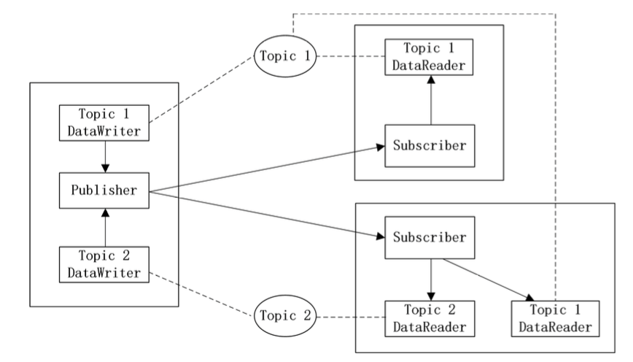
DDS Architecture

Slide 94
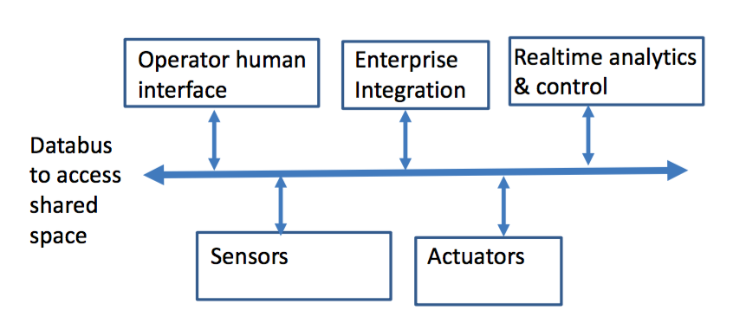
DDS Architecture

Slide 95
HTTP - Hyper Text Transfer Protocol

Slide 96
HTTP
HTTP (Hyper Text Transfer Protocol) is an application-layer protocol used for communicating between a client and a server.
HTTP is a request/response protocol. It specifies what clients can send to a server, and what they can expect to receive back
Originally HTTP was intended to transfer HTML documents from servers to browsers, but it’s now used for many different kinds of media.

Slide 97
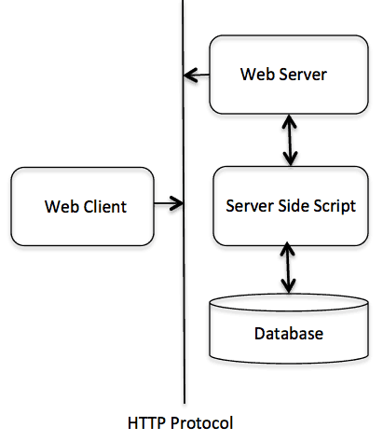
HTTP Basic Architecture

Slide 98
HTTP
The HTTP protocol is a request/response protocol based on the client/server-based architecture where web browsers, robots and search engines, etc. act like HTTP clients, and the Web server acts as a server.
Client
The HTTP client sends a request to the server in the form of a request method, URI, and protocol version, followed by a MIME-like message containing request modifiers, client information, and possible body content over a TCP/IP connection.

Slide 99
Server
The HTTP server responds with a status line, including the message's protocol version and a success or error code, followed by a MIME-like message containing server information, entity meta information, and possible entity-body content.

Slide 100
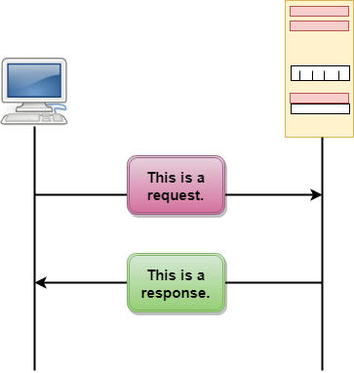
HTTP Transactions

Slide 101

Messages

Slide 102

Request Message:

Slide 103

Response Message:

Slide 104
Uniform Resource Locator (URL)
A client that wants to access the document in an internet needs an address and to facilitate the access of documents, the HTTP uses the concept of Uniform Resource Locator (URL).
The Uniform Resource Locator (URL) is a standard way of specifying any kind of information on the internet.
The URL defines four parts: method, host computer, port, and path.

Slide 105

Uniform Resource Locator (URL)

Slide 106
URL
Method: The method is the protocol used to retrieve the document from a server. For example, HTTP.
Host: The host is the computer where the information is stored, and the computer is given an alias name. Web pages are mainly stored in the computers and the computers are given an alias name that begins with the characters "www". This field is not mandatory.

Slide 107
URL
Port: The URL can also contain the port number of the server, but it's an optional field. If the port number is included, then it must come between the host and path and it should be separated from the host by a colon.
Path: Path is the pathname of the file where the information is stored. The path itself contain slashes that separate the directories from the subdirectories and files.

Slide 108
What is IP
An IP stands for internet protocol. An IP address is assigned to each device connected to a network. Each device uses an IP address for communication. It also behaves as an identifier as this address is used to identify the device on a network.
IP and TCP, are combined together, so together, they are referred to as a TCP/IP. It creates a virtual connection between the source and the destination.
An IP address consists of two parts, i.e., the first one is a network address, and the other one is a host address.

Slide 109
What is IP
There are two types of IP addresses:
IPv4
IPv6

Slide 110
What is IPv4?
IPv4 is a version 4 of IP. It is a current version and the most commonly used IP address. It is a 32-bit address written in four numbers separated by 'dot', i.e., periods. This address is unique for each device.
For example, 66.94.29.13
The above example represents the IP address in which each group of numbers separated by periods is called an Octet. Each number in an octet is in the range from 0-255. This address can produce 4,294,967,296 possible unique addresses.

Slide 111

What is IPv4?
The IPv4 consists of four sets, and these sets represent the octet. The bits in each octet represent a number.
Each bit in an octet can be either 1 or 0. If the bit the 1, then the number it represents will count, and if the bit is 0, then the number it represents does not count.
Representation of 8 Bit Octet
The above representation shows the structure of 8- bit octet.

Slide 112

To obtain the binary representation of the IP address:66.94.29.13
Step 1: First, we find the binary number of 66.
To obtain 66, we put 1 under 64 and 2 as the sum of 64 and 2 is equal to 66 (64+2=66), and the remaining bits will be zero, as shown above. Therefore, the binary bit version of 66 is 01000010.

Slide 113

To obtain the binary representation of the IP address:66.94.29.13
Step 2: Now, we calculate the binary number of 94.
To obtain 94, we put 1 under 64, 16, 8, 4, and 2 as the sum of these numbers is equal to 94, and the remaining bits will be zero. Therefore, the binary bit version of 94 is 01011110.

Slide 114

To obtain the binary representation of the IP address:66.94.29.13
Step 3: The next number is 29.
To obtain 29, we put 1 under 16, 8, 4, and 1 as the sum of these numbers is equal to 29, and the remaining bits will be zero. Therefore, the binary bit version of 29 is 00011101.

Slide 115

To obtain the binary representation of the IP address:66.94.29.13
Step 4: The last number is 13.
To obtain 13, we put 1 under 8, 4, and 1 as the sum of these numbers is equal to 13, and the remaining bits will be zero. Therefore, the binary bit version of 13 is 00001101.

Slide 116
What is IPv6?
IPv4 produces 4 billion addresses, and the developers think that these addresses are enough, but they were wrong. IPv6 is the next generation of IP addresses. The main difference between IPv4 and IPv6 is the address size of IP addresses.
The IPv4 is a 32-bit address, whereas IPv6 is a 128-bit hexadecimal address. IPv6 provides a large address space, and it contains a simple header as compared to IPv4.
This hexadecimal address contains both numbers and alphabets. Due to the usage of both the numbers and alphabets, IPv6 is capable of producing over 340 undecillion (3.4*10³⁸) addresses.

Slide 117


What is IPv6
IPv6 is a 128-bit hexadecimal address made up of 8 sets of 16 bits each, and these 8 sets are separated by a colon. In IPv6, each hexadecimal character represents 4 bits. So, we need to convert 4 bits to a hexadecimal number at a time
The address format of IPv4:
The address format of IPv6:

Slide 118
6LoWPAN
The 6LoWPAN protocol refers to IPv6 Low Power Personal Area Network which uses a lightweight IP-based communication to travel over low data rate networks.
It has limited processing ability to transfer information wirelessly using an internet protocol. So, it is mainly used for home and building automation.
The 6LoWPAN protocol operates only within the 2.4 GHz frequency range with 250 kbps transfer rate. It has a maximum length of 128-bit header packets.

Slide 119
6LoWPAN
Based on 802.15.4 protocol at physical layer, the standard has been developed for addressing of IOT sensors and devices in a Wireless Sensor Network (WSN).
This protocol is a modified version of IPv6 with intention to implement Internet protocol to each and every devices (constrained devices as well as large devices) and the low power devices with limited capabilities like less memory, lossy network etc.

Slide 120
6LoWPAN
6LoWPAN networks connect to the Internet via a gateway (WiFi or Ethernet), which does some process for protocol conversion so that device can communicate with Internet.
Specifically, the adaptation layer performs the following three optimizations in order to reduce communication overhead –
1) Header Compression — Ipv6 supports packet header length of 127 byte. So, 6loWPAN defines header compression of IPv6 packets for decreasing the overhead of IPv6.

Slide 121
6LoWPAN
2) Fragmentation — The minimum MTU size (maximum transmission unit) of IPv6 is 1280 bytes. On the other hand, the maximum size of a frame in IEEE 802.15.4 is 127 bytes. Therefore, the IPv6 packet need to be fragmented. This is done by the adaptation layer.
3) Link Layer Forwarding — 6LoWPAN also supports mesh under routing, which is done at the link layer using link level short addresses. This feature can be used to communicate within a 6LoWPAN network.

Slide 122
IoT WIRED COMMUNICATION
• IoT technology is deployed in many ways so no single network solution is right. It depends on the situation and where the devices are located. Some of the factors affecting the selection of the type of network are
– network range
– network bandwidth
– power usage
– Interoperability
– intermittent connectivity
– security.

Slide 123
IoT WIRED COMMUNICATION
• A wired network uses Ethernet cable to connect to the network. The Ethernet cable is in turn connected to a DSL or cable to the network gateway. The wired networks are mature technology, and it is easy to get plugged into if you already have phone lines, power lines, and coaxial cable lines.
BENEFITS OF THE WIRED MONITORING DEVICES
– Reliability: Less prone to dropped connections.
– Speed: Wired connectivity is much faster than wireless. Wired data transmissions are not sensitive to distances and has no effect on the performance of the connection.
– Security: Cannot be hacked or tapped

Slide 124
IoT WIRED COMMUNICATION
• DISADVANTAGES
– Cost: Wired connections are more expensive than wireless due to the cost of the wire, labor costs for installation.
– Mobility: No mobility
– Scalability: Scalability would be an issue not only for networks to be up and running quickly but also for the planning and cost purposes.

Slide 125

IoT POWER SOURCES

